Slide 1
Database System

Slide 2
Database definitions
Def 1: A shared collection of logically related data, designed to meet the information needs of multiple users in an organization.
Def 2: A collection of information organized and presented to serve a specific purpose. (A telephone book is a common database.) A computerized database is an updated, organized file of machine readable information that is rapidly searched and retrieved by computer.

Slide 3
Database definitions
Def 3: A data structure that stores metadata, i.e. data about data. More generally we can say an organized collection of information.
Def 4: An organized collection of information in computerized format.
Each of the above given definition is correct, and describe database from slightly variant perspectives

Slide 4
Thing Data (Facts or figures)
Cricket Player Country, name, date of birth, specialty, matches played, runs etc.
Scholars Name, data of birth, age, country, field, books published etc.
Food Name, ingredients, taste, preferred time, origin, etc.
Vehicle Registration number, make, owner, type, price, etc.

Slide 5
Databases and Traditional File Processing Systems
Traditional file processing system or simple file processing system refers to the first
computer-based approach of handling the commercial or business applications

Slide 6
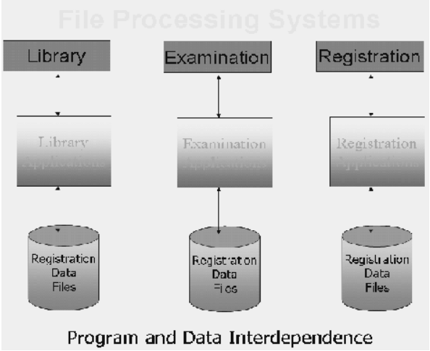
File Processing Systems
Library Application
Examination Application
Registration Application
Library data files
Examinationdata files
Registration data files

Slide 7
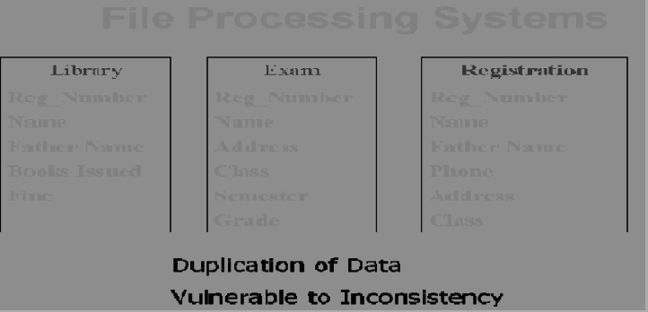
File Processing Systems

Slide 8
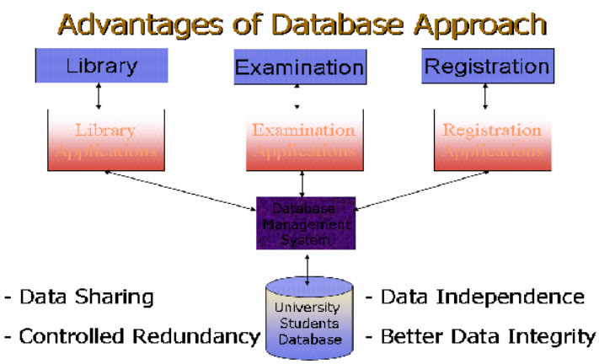
Database Management System

Slide 9
Data & Information
Company: Super Soft Dept: Sales
Emp Name Age Salary
Malik Sharif | 23 | 55
Sh. M. Akmal | 24 | 55
M. A. Butt | 20 | 40
Malik Junaid | 19 | 20

Slide 10
Schema
Database Applications
Database Management System (DBMS)
Management of Data in the Database
Management of Users associated with the database.

Slide 11
Other Advantages
Data consistency
Better data security
Faster development of new applications

Slide 12
They also provide
Better concurrency control
Better backup and recovery procedures

Slide 13
Disadvantages
Higher costs
SW, HW, and Technical staff
Conversion cost
From old system to DB system
More difficult recovery
Needs more technical staff
Notes:
Higher Costs include HW, SW, trained staff
Conversion Cost includes from Manual to DB or from File system to DB, both involve costs

Slide 14
Data As Resource
Resource
Any asset that is of value to an organization and that incurs cost
Notes:
3/17

Slide 15
Is data a resource ?
YES

Slide 16
Levels of Data,
Entity, Attribute
e.g. A student,
A class name
Real World Data
Record type, Data item type e.g. Student record type
Metadata
Data Occurrences
Student record, Data item occurrence e.g.
‘s001’, ’Amir’, ‘CS101’
Notes:
Explain from this and later text followed by this diagram

Slide 17
Employee
name, age, sal
Emp
Name text
Age number
Sal number
Malik Sharif | 23 | 55
Sh. M. Akmal | 24 | 55
M. A. Butt | 20 | 40
Malik Junaid | 19 | 20

Slide 18
Levels of Data
Real-world data
Student (Name, DOB, Class)
Metadata
Name , Character Type, 25 character size field,
DOB, Date type, 8 bytes size
Class, Alpha Numeric, 8 byte size field
Data Occurrence
Name DOB Class
Ali 20/8/1994 BS-I
Amir 22/3/1993 BS-II etc…
Notes:
4/21

Slide 19
Database Users
Application Programmers
End Users
Naïve
Sophisticated
Database Administrator (DBA)
A person who has central control over data and programs that access this data

Slide 20
Functions of DBA
Schema definition
Granting data access
Routine Maintenance
Backups
Monitoring disk space
Monitoring jobs running

Slide 21
Typical Components
End users
Software
interact
Application Programs
Application Programmers
develop
“What” to get
DBMS
Database Administrators
maintain
Data
“How” to get
Database
Designers
Database
design
Users

